Slide 1

Home Page
Notes:
image
No alt text provided
shape
No alt text provided
shape
No alt text provided

Slide 2
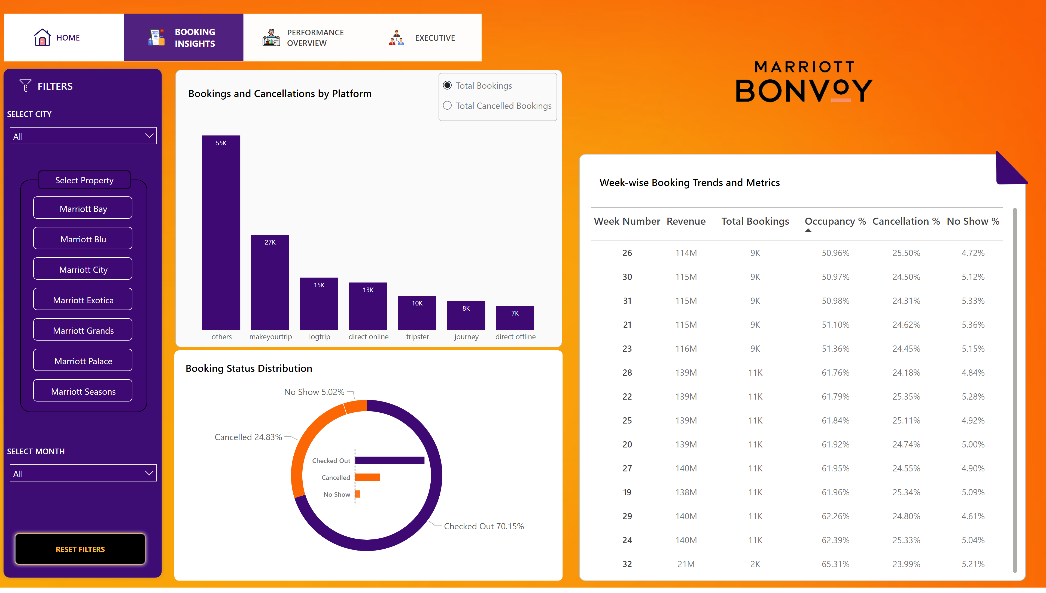
Booking Insights View
Notes:
shape
No alt text provided
donutChart
No alt text provided
columnChart
No alt text provided
shape
No alt text provided
shape
No alt text provided
shape
No alt text provided
shape
No alt text provided
shape
No alt text provided
shape
No alt text provided
advancedSlicerVisual
No alt text provided
image
No alt text provided
shape
No alt text provided
shape
No alt text provided
SELECT CITY
No alt text provided
slicer
No alt text provided
shape
No alt text provided
clusteredBarChart
No alt text provided
shape
No alt text provided
shape
No alt text provided
pivotTable
No alt text provided
shape
No alt text provided
image
No alt text provided
shape
No alt text provided
SELECT MONTH
No alt text provided
shape
No alt text provided
actionButton
No alt text provided
actionButton
No alt text provided
actionButton
No alt text provided
actionButton
No alt text provided

Slide 3
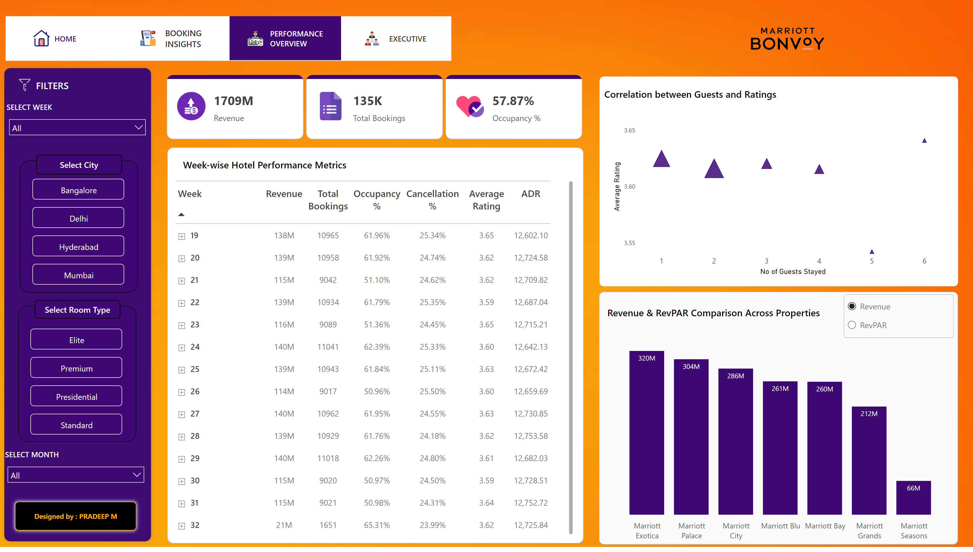
Performance Overview
Notes:
columnChart
No alt text provided
shape
No alt text provided
shape
No alt text provided
slicer
No alt text provided
shape
No alt text provided
shape
No alt text provided
shape
No alt text provided
shape
No alt text provided
shape
No alt text provided
shape
No alt text provided
shape
No alt text provided
advancedSlicerVisual
No alt text provided
image
No alt text provided
SELECT WEEK
No alt text provided
shape
No alt text provided
shape
No alt text provided
scatterChart
No alt text provided
shape
No alt text provided
pivotTable
No alt text provided
shape
No alt text provided
image
No alt text provided
SELECT MONTH
No alt text provided
advancedSlicerVisual
No alt text provided
shape
No alt text provided
shape
No alt text provided
columnChart
No alt text provided
Net Sales
No alt text provided
shape
No alt text provided
actionButton
No alt text provided
actionButton
No alt text provided
actionButton
No alt text provided
actionButton
No alt text provided

Slide 4
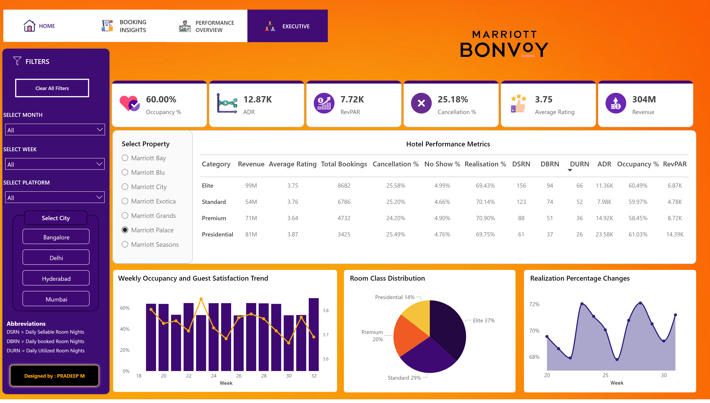
Executive View
Notes:
shape
No alt text provided
shape
No alt text provided
shape
No alt text provided
shape
No alt text provided
shape
No alt text provided
shape
No alt text provided
advancedSlicerVisual
No alt text provided
image
No alt text provided
SELECT WEEK
No alt text provided
shape
No alt text provided
pivotTable
No alt text provided
shape
No alt text provided
SELECT MONTH
No alt text provided
columnChart
No alt text provided
Net Sales
No alt text provided
actionButton
No alt text provided
SELECT PLATFORM
No alt text provided
shape
No alt text provided
slicer
No alt text provided
shape
No alt text provided
lineStackedColumnComboChart
No alt text provided
shape
No alt text provided
shape
No alt text provided
pieChart
No alt text provided
shape
No alt text provided
shape
No alt text provided
shape
No alt text provided
shape
No alt text provided
areaChart
No alt text provided
shape
No alt text provided
shape
No alt text provided
shape
No alt text provided
shape
No alt text provided
shape
No alt text provided
actionButton
No alt text provided
actionButton
No alt text provided
actionButton
No alt text provided
actionButton
No alt text provided
image
No alt text provided

